Slide 1
Level 4 Individual Project
A Distributed Game Using Adverts And Trackers In Web Browsers
Eftychios Karagiorgis - 2329664k
Notes:
Hi, my name is Eftychios Karagiorgis and this is my presentation for the Level 4 Individual Project.

Slide 2
Contents
Introduction and Motivation
Targeted advertising and tracking
Privacy and Discrimination issues in targeted advertising systems
Demo of completed product
Experiment and Results
Notes:
Just to mention briefly the contents of the presentation. I will start by introducing the concepts in the project as well as what our aims were. Then I will talk a bit about targeted advertising systems and tracking in web browsers followed by a discussion on the various issues in these systems. After that, there will be a short demo of the completed product followed by a walkthrough of the experiment and the results.

Slide 3
Introduction and Motivation
Targeted advertising systems and tracking in web browsers are highly controversial and cause concerns amongst internet users over privacy of personal data.
Aims: In this project, we created an online multiplayer game that uses adverts and trackers in web browsers as gameplay mechanics in an attempt to explore and improve the knowledge that user’s have about targeted advertising systems and expose them to the various issues involved in them.
Notes:
... The controversy in these systems comes from the lack of knowledge that users have of how they work or what data they collect from the users. If users were more knowledgeable in these systems, then they would have been able to make more informed decisions when browsing the web to better preserve their privacy.

Slide 4
Targeted advertising and tracking
Targeted advertising is the process of serving personalised adverts to users based on an interest profile that is created by data gathered from the user’s browsing activity through tracking mechanisms.
There two main types of data gathered from the user:
Browsing behaviour
Demographics
Many entities are involved in these systems with the ultimate goal to deliver the right ads to the right users as well as to maximise the advertiser’s and the publisher’s profits.
Notes:
… Publishers in this case are the websites that the advert is displayed on. Publishers sell their ad spaces to advertisers through automated auctions, in which the advertisers bid on the ad space. These auctions occur when the user visits a publisher’s website and advertisers can select if they want to bid for the ad space or not depending on the user’s interest profile.
Browsing behaviour: Usually data about the interactions of the user in various websites such as a record of their search terms
Demographics: Data such as the age, gender or education of the user.

Slide 5
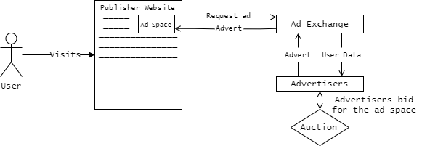
Real-time bidding (RTB)
Real-time bidding (RTB) is an automatic process that happens when a user first visits a website that is associated with an ad exchange.
Notes:
Real-time bidding (RTB) is an automatic process that happens when a user first visits a publisher’s website that is associated with an ad exchange. An HTTP request is made to the ad exchange which is responsible for fulfilling these types of requests.
The ad exchange then notifies its advertisers that an ad space is available and shares with them any data they have about the user.
The auction then takes place and the advertiser who bids the most will have their advert served to the user.
The advert is then served to the user by the ad exchange through an HTTP response object. The response usually is an iframe HTML element that contains as children the advert element/.

Slide 6
Privacy Issues and Discrimination Issues in targeted advertising systems
Lack of transparency on how they work and what data they collect
Lack of control on the user’s side
Discrimination
Potential data leaks of user data
Notes:
What are the issues then with this infrastructure?

Slide 7
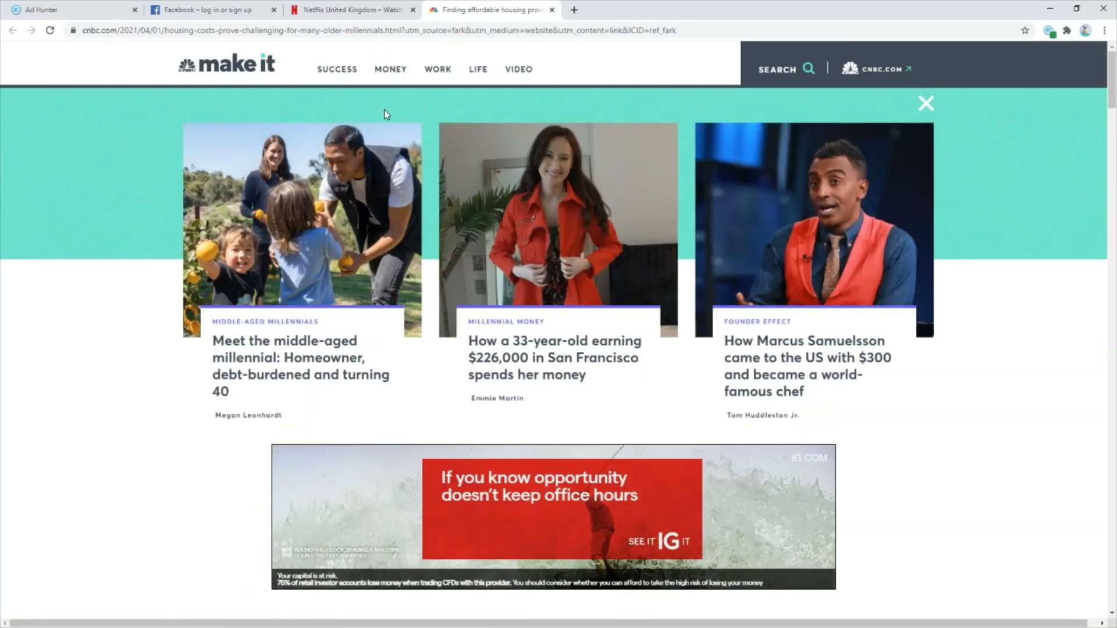
Demo
Notes:
Create an account and play around with the website while explaining the different parts of the product.
Start a game of Race mode and play it until the end while explaining what happens with the extension.
Summary, achievements and page history.

Slide 8
Experiment and Results
Experiment: Participants were asked to play a single game of the Race mode and answer questions in a survey.
Results: Almost all participants reported that they had an increase in knowledge in at least one of the aspects of these systems after playing just a single game.
In terms of system usability we calculated an average SUS score of 80, which falls slightly short of being excellent according to the SUS score distributions and it is classified as a good score.
Notes:
… These questions were aimed at evaluating the participant’s knowledge about different aspects of targeted advertising systems before and after playing the game. Using the System Usability Scale or SUS for short, participants were also asked to answer question related to the usability of the system.
… This means that users found our system quite enjoyable and easy to use and had no particular trouble using the different functionalities in the system

Slide 9
Conclusion
This project involved the creation of an educational game meant to improve the user’s knowledge of targeted advertising systems.
With the web application deployed, we ran an experiment in order to evaluate our system and determine if the player’s knowledge about certain aspects of targeted advertising systems was improved after playing the game
We observed that almost all participants reported an increase in knowledge in at least one aspect of targeted advertising systems by playing just a single game of the Race mode.
Notes:
The game uses trackers and adverts as game resources in two different game modes and the premise is that by interacting with the game, users can observe directly and understand better what is happening behind the scenes in terms of tracking and advertising when they visit different websites.
While our evaluation was limited due to the small number of participants, we observed that almost all participants reported an increase in knowledge in at least one aspect after playing a single game of the Race mode.
This is an important result, as these concepts are complex and difficult to comprehend without the appropriate background knowledge and an interactive game can be more appealing to users than a mountain of text. However, a more thorough evaluation is needed to reach this conclusion, as there is not enough evidence to say for certain that the participant’s knowledge was improved.

Slide 10
Thank you!

Slide 11
References:
N. Bol, J. Strycharz, N. Helberger, B. van de Velde, and C. De Vreese. Vulnerability in a tracked society : Combining tracking and survey data to understand who gets targeted with what content. New Media & Society, 2019. ISSN 1461-4448. doi: 10.1177/1461444820924631.
J. Brooke. Sus: A quick and dirty usability scale. Usability Eval. Ind., 189, 11 1995.
J. Estrada-Jimenez, J. Parra-Arnau, A. Rodriguez-Hoyos, and J. Forne. Online advertising: Analysis of privacy threats and protection approaches. Computer Communications, 100:32–51, 2017. ISSN 01403664. doi: 10.1016/j.comcom.2016.12.016.

